Slide 1
CP1404/CP5632 Programming 1
Subject, Computers, Machine code, Programming languages, VMs

Slide 2
Overview of CP1404
Builds upon CP1401, continue developing:
Problem solving skills
Programming skills, using Python
Is the basis for the other subjects
E.g. CP2406 (Programming 2, Java)
Introduces fundamental principles and practices of computer programming with an industry-level programming language
Start to use industry-standard tools and practices like version control with Git and GitHub

Slide 3
Overview of CP5632
Includes the same content as CP1404
With an expanded focus on programming languages and programming environments
Note: We understand that CP5632 students may not have done any programming before. Workshops at the start of the subject are provided to help you get up to speed quickly.
You will need to do a lot of work at the start so we can keep moving at a good pace.
Make extra time in the first few weeks to learn and practise basic programming

Slide 4
Skill development
How to use a modern Integrated Development Environment
How to apply best-practice "clean" coding techniques
Perform application prototyping
Apply testing and debugging techniques
How to use self-learning practices
How to use Git/GitHub version control

Slide 5
Knowledge development
Software development principles
Graphical user interface (GUI) programming
Object-oriented (OO) programming
The history of computer programming

Slide 6
Contact Hours
1 x 2hr lecture per week
Content introduction, coding demonstrations and guided in-class activities
1 x 2hr coding workshop per week
Based on the lecture content
Progressively introduce skills
With suggestions for at-home practice (do this!)
CP5632 also includes 6 x 1hr workshops
First 4 focus on early programming development
Later 2 focus on technical report and presentation

Slide 7
Assessing your skills and knowledge
Skills: develop programs written in Python using Kivy
Assessed by: two assignments (40%), practicals (30%)
Knowledge: recall and application of Python and programming concepts (including on-paper coding)
Assessed by a final exam (30%) (no mid-semester test)
Every 2nd week there are online revision tests which contribute to your practical mark
Please note:
All assessment graded at an “introductory” level
Assessment is individually submitted (no group work)

Slide 8
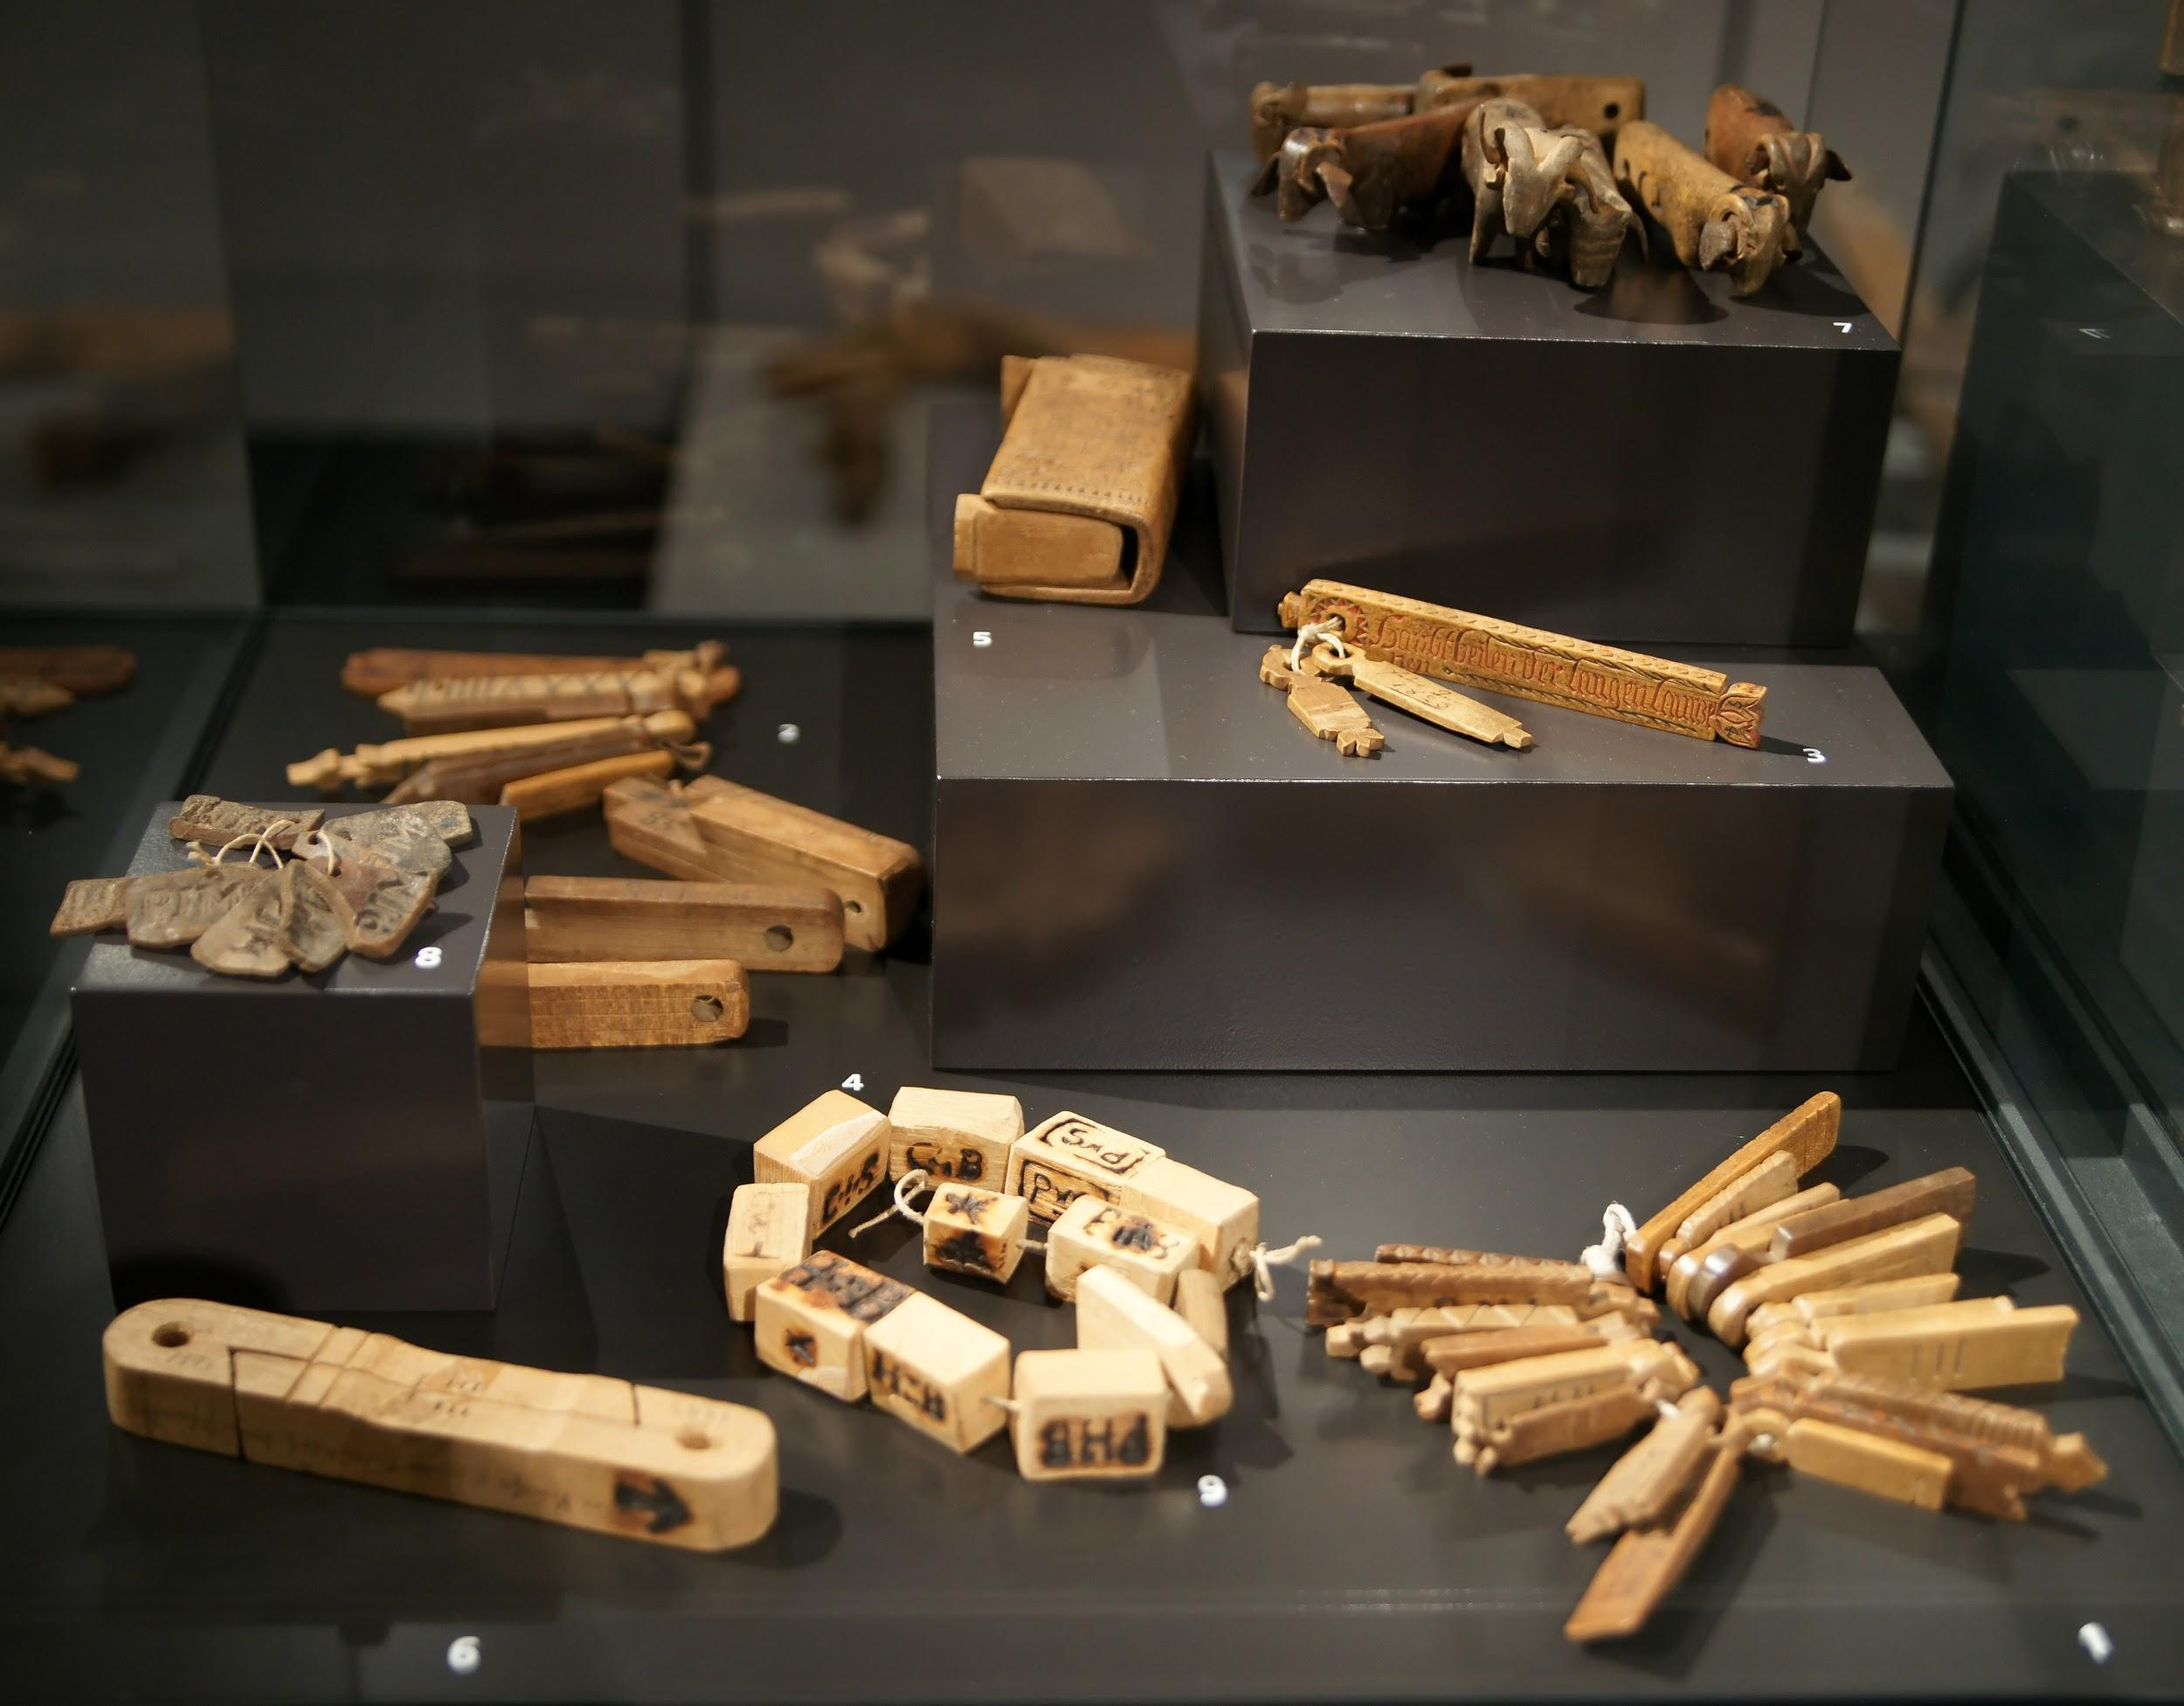
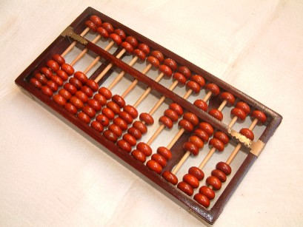

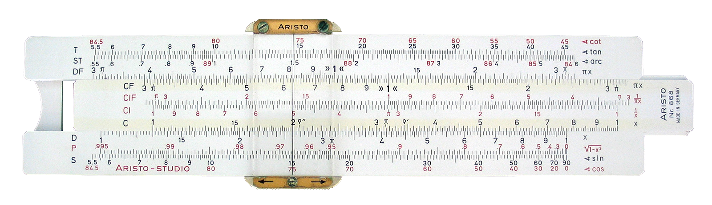
What is a computer?
Tally sticks (~19000 BC)
Abacus (~2500 BC)
Slide Rule (~1625 AD)
Notes:
The ancient notion of a computer:
A tool that helps a human performs calculations (e.g. abacus, tally-sticks, slide-rule)
The human performs a series of operations with the tool
"SAM PC 1 - Tally sticks 1 - Overview" by Own photograph by Sandstein. Licensed under CC BY 3.0 via Wikimedia Commons - http://commons.wikimedia.org/wiki/File:SAM_PC_1_-_Tally_sticks_1_-_Overview.jpg#mediaviewer/File:SAM_PC_1_-_Tally_sticks_1_-_Overview.jpg
"Sliderule 2005" by Sliderule_2005.jpg: Roger McLassusderivative work: Beao - Sliderule_2005.jpg. Licensed under CC BY-SA 3.0 via Wikimedia Commons - http://commons.wikimedia.org/wiki/File:Sliderule_2005.png#mediaviewer/File:Sliderule_2005.png

Slide 9
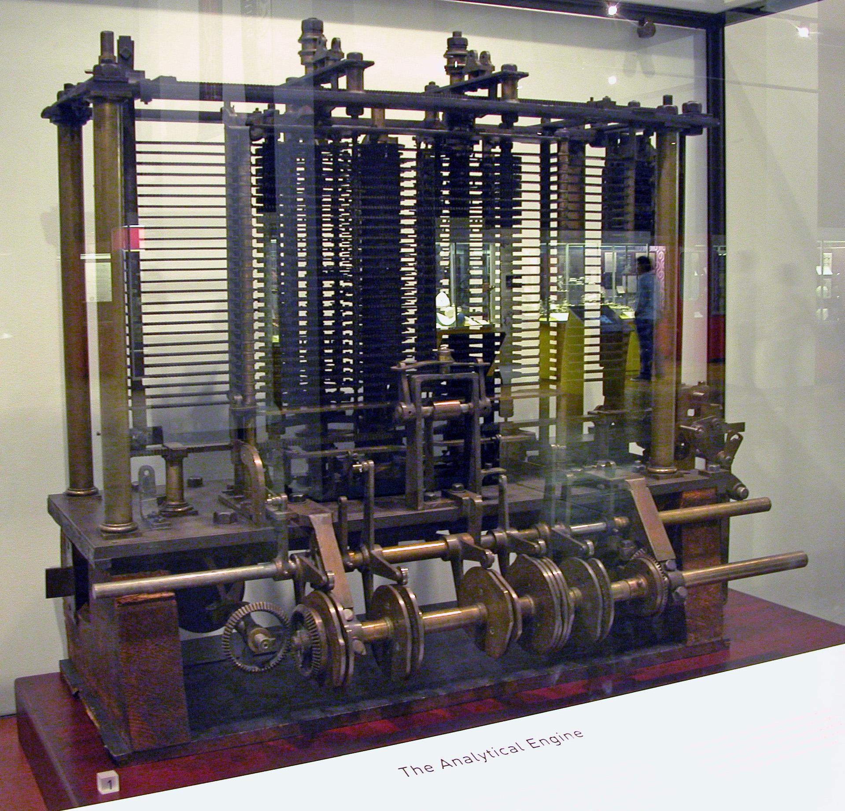
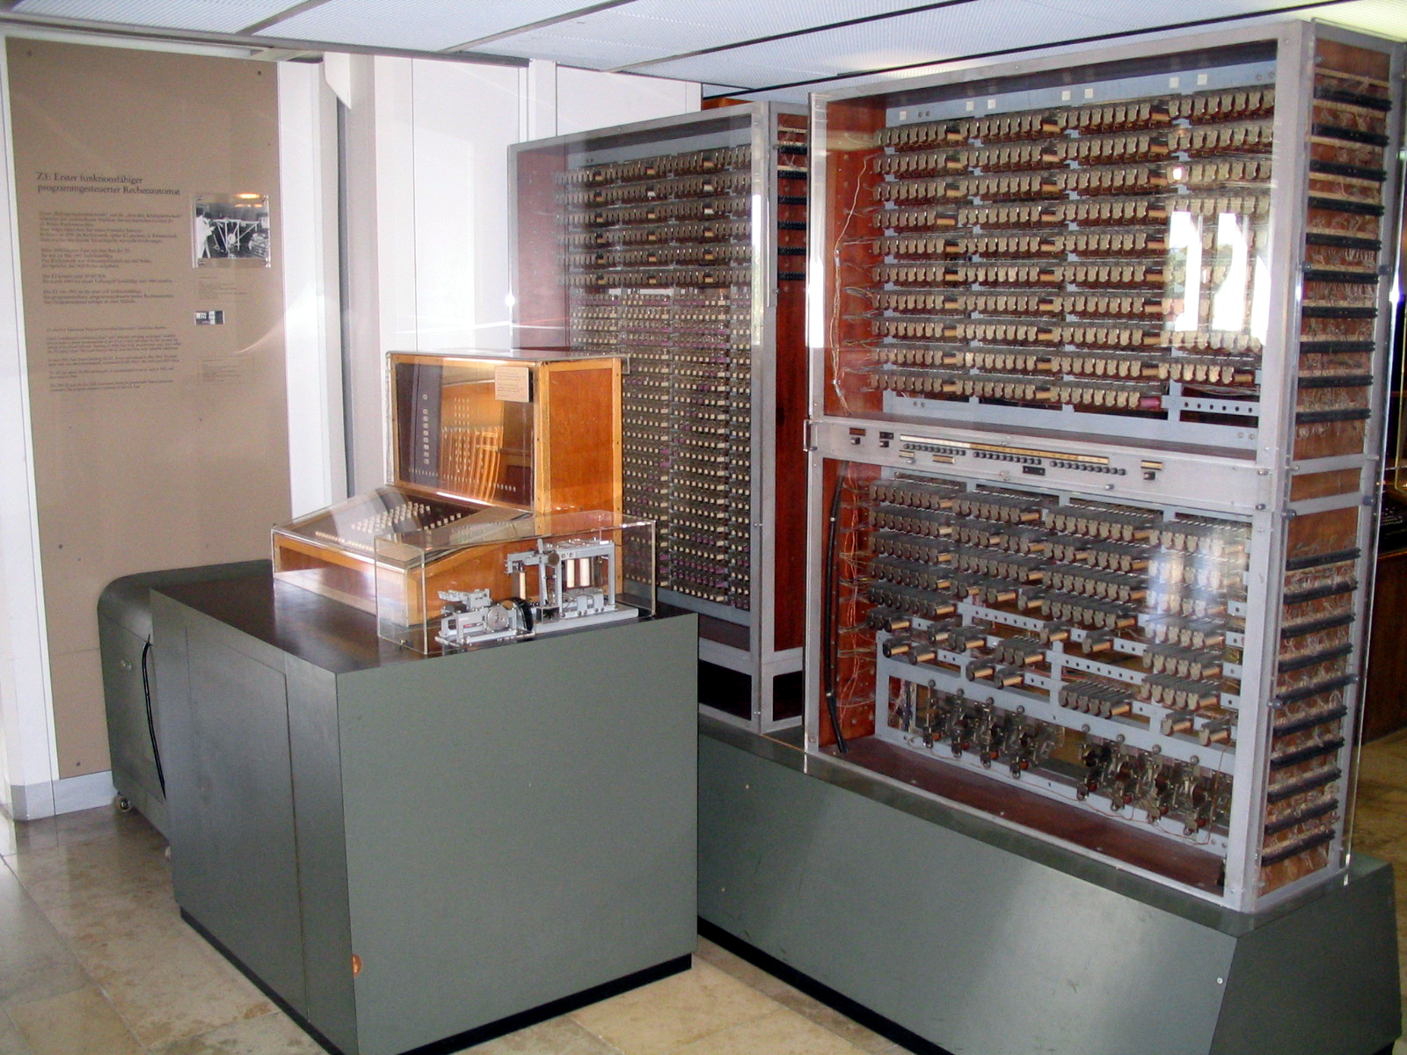
What is a computer?
Analytical Engine (~1830s)
Zuse Z3 (1941)
Notes:
The modern notion of a computer: A device that we program to automatically execute program code
Analytical Engine - mechanical computer, first general purpose computer, used punch-cards for program, uses decimal numbers
Zuse Z3 - electro-mechanical, programmed using punch film, used binary for representing numbers, and pioneered the representation floating-point numbers
"AnalyticalMachine Babbage London" by Bruno Barral (ByB). Licensed under CC BY-SA 2.5 via Wikimedia Commons - http://commons.wikimedia.org/wiki/File:AnalyticalMachine_Babbage_London.jpg#mediaviewer/File:AnalyticalMachine_Babbage_London.jpg
"Z3 Deutsches Museum" by Venusianer at the German language Wikipedia. Licensed under CC BY-SA 3.0 via Wikimedia Commons - http://commons.wikimedia.org/wiki/File:Z3_Deutsches_Museum.JPG#mediaviewer/File:Z3_Deutsches_Museum.JPG

Slide 10

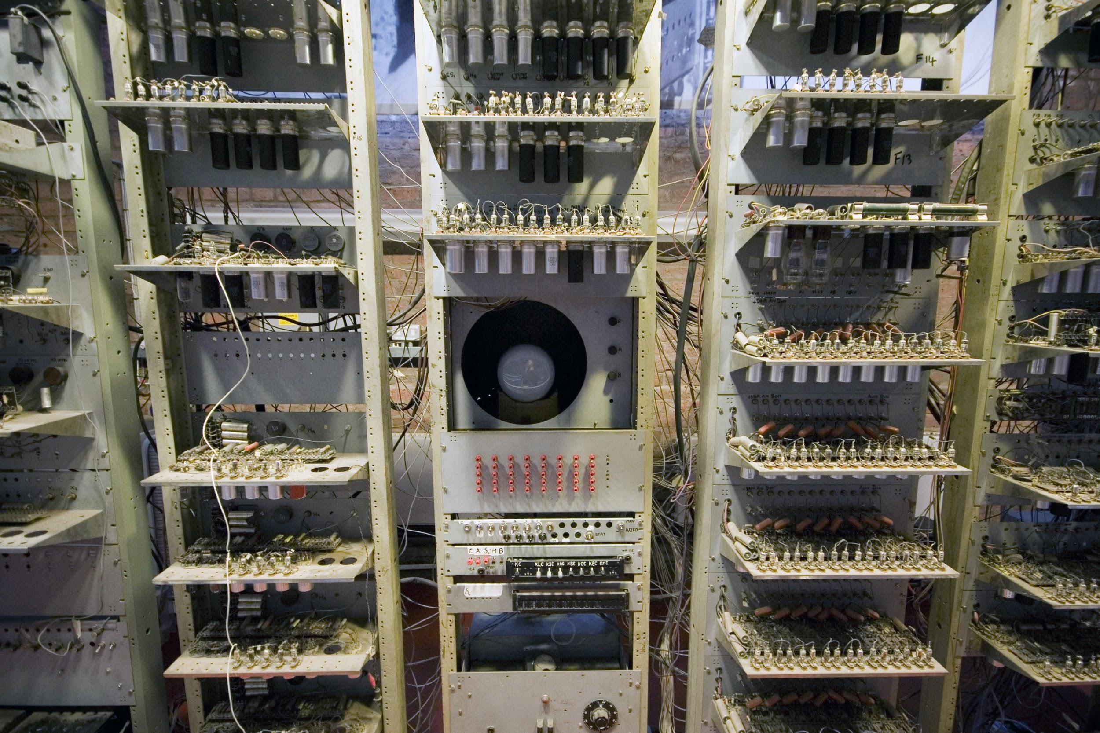
What is a computer?
ENIAC (~1946)
Baby (~1948)
Notes:
ENIAC - one of the first “turing-complete” computers, programmed by the state of its patch-cables
Baby - first stored-program computer
"Eniac" by Unknown - U.S. Army Photo. Licensed under Public Domain via Wikimedia Commons - http://commons.wikimedia.org/wiki/File:Eniac.jpg#mediaviewer/File:Eniac.jpg

Slide 11
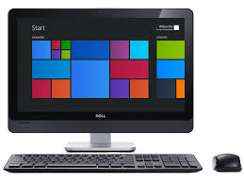

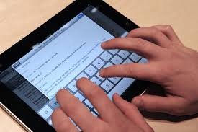
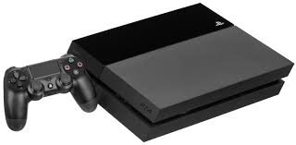
What is a computer?
Modern computers...
Notes:
Baby - first stored-program computer
"SSEM Manchester museum close up" by Parrot of Doom - Own work. Licensed under CC BY-SA 3.0 via Wikimedia Commons - http://commons.wikimedia.org/wiki/File:SSEM_Manchester_museum_close_up.jpg#mediaviewer/File:SSEM_Manchester_museum_close_up.jpg

Slide 12
A Computer is …
Ancient definition:
A specialised tool to aid humans doing calculations
The human does the work, the tool supports them
Modern definition:
A general-purpose device that performs tasks
The human programs the computer, and the computer runs the tasks automatically

Slide 13
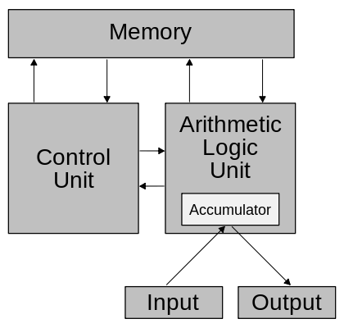
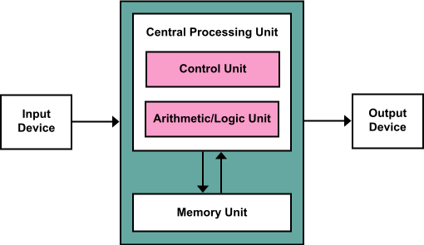
Alan Turing and John Von Neumann independently developed the “stored-program” computer architecture
But Von Neumann’s designs become well-known:
Notes:
Von Neumann’s designs appear in press before Turing’s and hence the chosen naming was “Von Neumann Architecture”

Slide 14
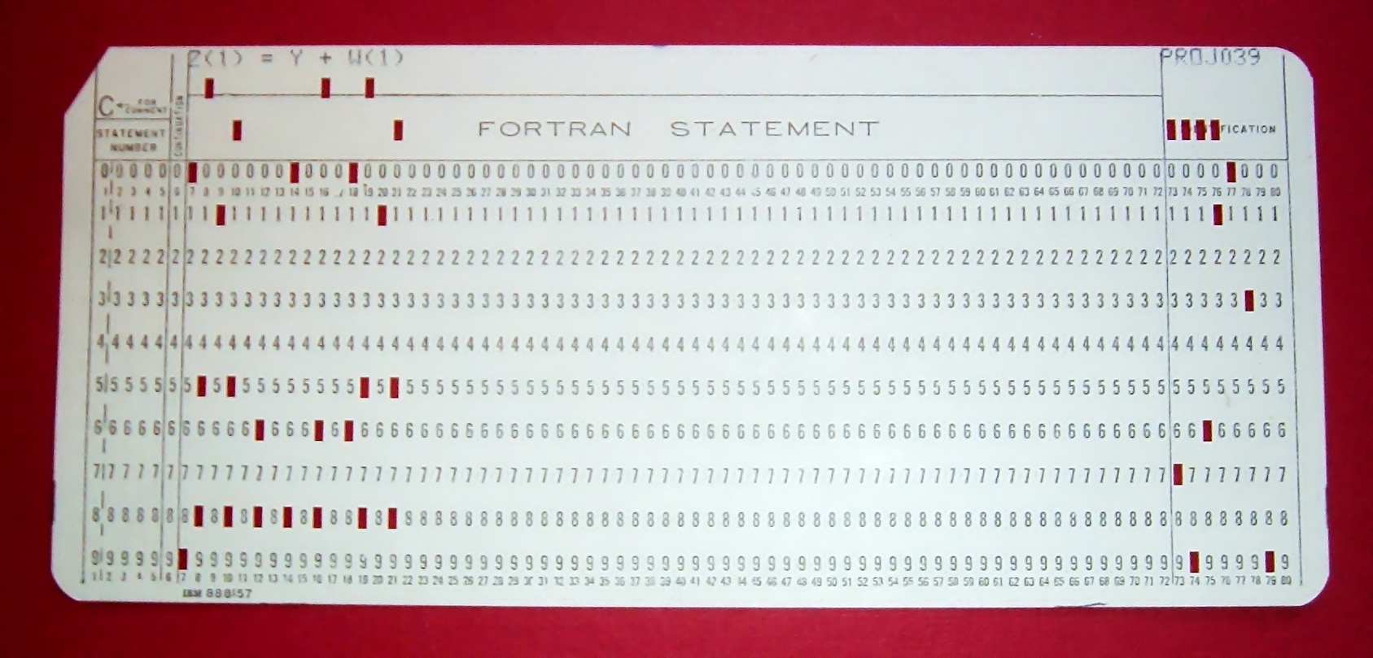
In a stored-program computer, the program
and its data are both stored in memory
Before this idea, programs were separate from the data:
E.g. punch-cards, the arrangement of cables
Notes:
"FortranCardPROJ039.agr" by Arnold Reinhold - I took this picture of an artifact in my possession. The card was created in the late 1960s or early 1970s and has no copyright notice.. Licensed under CC BY-SA 2.5 via Wikimedia Commons - http://commons.wikimedia.org/wiki/File:FortranCardPROJ039.agr.jpg#mediaviewer/File:FortranCardPROJ039.agr.jpg

Slide 15
Components of a modern computer
Memory Unit - stores program code and data
Arithmetic / Logic Unit - performs math operations
Control Unit - executes programs
Input / Output Devices
Display, Keyboard, ...
Notes:
CPU is the ALU and the CU together

Slide 16
A general-purpose modern computer understands machine code
Machine code is a set of primitive instructions for performing arithmetic and logic operations
A program can be written as machine code
The Control Unit executes machine code stored in memory using the fetch-decode-execute cycle:
Fetch the next instruction
Decode that instruction
Execute that instruction

Slide 17
What is a program?
A series of instructions that a modern computer can execute
A program allows you to tell a computer what to do
We write programs that allow us to solve problems on computer

Slide 18
What is a programming language?
It is hard to write even a simple program in machine code - humans don’t think like a computer!
As programs became more sophisticated, resolving this issue became more important
Programming languages were invented to make programming easier for humans

Slide 19
A programming language is an abstraction
Abstraction means “hide the details”
it’s a powerful and important concept in IT
Instead of machine code, a program written in a programming language is closer to how humans think
Instead of a complex sequence of machine code operations, often a single expression or statement can be used

Slide 20
History of programming
http://www.levenez.com/lang/ provides a very interesting chart of the development of 50 programming languages
Some historians recognise Ada Lovelace's work in 1842 as the world's first computer program
Herman Hollerith encoded data on punch cards (used for train tickets) around 1890
Programming languages designed to communicate instructions to a modern electronic computer were written in the 1950s
Notes:
https://en.wikipedia.org/wiki/History_of_programming_languages

Slide 21
History of programming
Languages (and their historical development) are sometimes classified in terms of their "generation"
Sometimes this is basically just marketing
It is very rough and not used much
You will find different versions around the place
1GL (First Generation Language) - low-level machine language
2GL - low-level assembly language
3GL - high-level languages, like C
4GL - similar to human language, like SQL
5GL - include visual tools, like Visual Basic

Slide 22
Different programming languages have different syntax and semantics
Syntax means “how something is written”
Semantics means “the behaviour something has”
There are many programming languages
Because different problems are easier to solve using different syntax and semantics

Slide 23
A program written in a programming language is translated into machine code
A computer only understands machine code
So programs written in a programming language must be converted into machine code
We call this “translation” - from programming language code into machine code

Slide 24
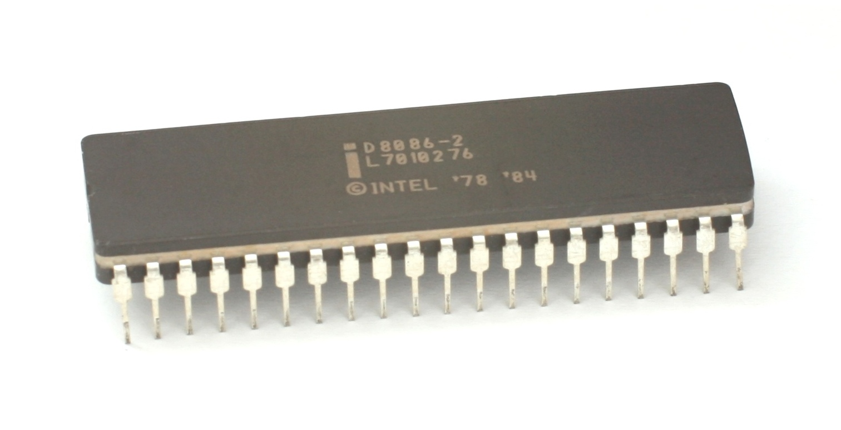
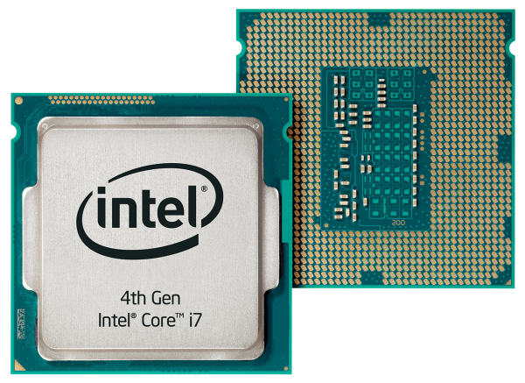
Many computers use the Intel x86 chip architecture
8086: ~1978
Haswell: ~2013

Slide 25
The x86 machine code is complex...
Code | Meaning
ADC | add with carry
ADD | add
AND | logical and
CALL | function call pushing program counter onto the stack
DEC | decrease by 1
DIV | unsigned divide
HLT | stop the computer
hundreds more...
Notes:
http://en.wikipedia.org/wiki/X86_instruction_listings

Slide 26
Python compiles to something closer to machine code called bytecode
Python code | Python bytecode
value = 1 value = value + 1 print(value) | 1 0 LOAD_CONST 0 (1) 3 STORE_NAME 0 (value) 2 6 LOAD_NAME 0 (value) 9 LOAD_CONST 0 (1) 12 BINARY_ADD 13 STORE_NAME 0 (value) 3 16 LOAD_NAME 1 (print) 19 LOAD_NAME 0 (value) 22 CALL_FUNCTION 1 (1 positional, 0 keyword pair) 25 POP_TOP 26 LOAD_CONST 1 (None) 29 RETURN_VALUE
NOTE: A Python program is translated into bytecode before it is executed on a real computer.
Notes:
For more, check out https://docs.python.org/3.4/library/dis.html

Slide 27
Answer the following questions about the Python bytecode we just looked at...
What do think the first column of numbers mean in the bytecode output?
What do you think the second column of numbers mean?
In your own words, describe the term “program translation”.
We estimate that a Python program with X lines of code will have an equivalent bytecode program of ____________ lines of code.

Slide 28
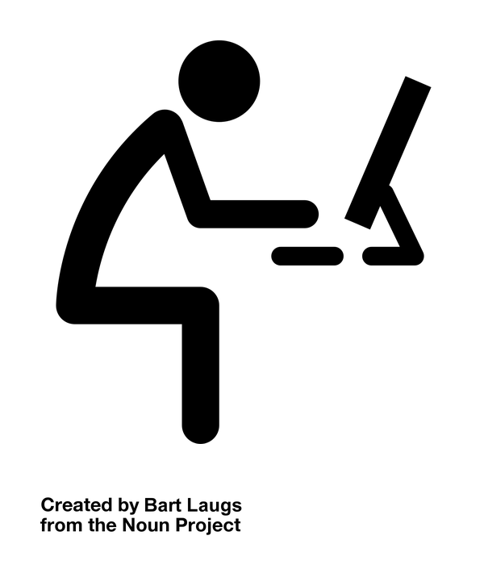
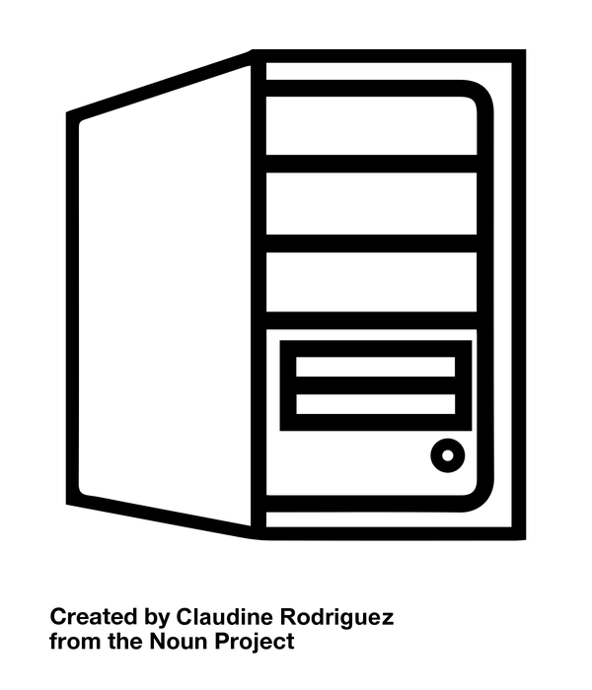
A typical program needs to: get input, process data, and output results
A program gets input from a variety of input devices
Keyboard, mouse, touch screen, sensors, ...
It then processes the inputs as data in various ways
Results are then formatted and sent to various output devices
Screen, printer, sent across the Internet, ...

Slide 29

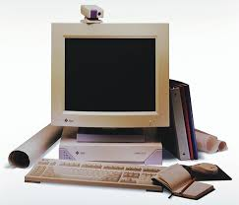

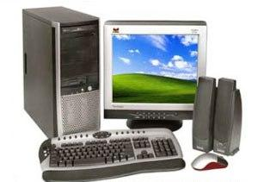
However, the reality is messy...
You have to rewrite your program to suit each type of Operating System and computer hardware - not very practical!
MyProgram
Mac-version
MyProgram
PC-version
MyProgram
SUN-version

Slide 30
One solution: simulate the functionality of OSes and hardware as a program - we call this a virtual machine
Source code
Compiled
Bytecode
runs on
Virtual machine
Operating System
Computer hardware

Slide 31
Bytecode is the machine code that runs on a Virtual Machine (VM)
When you install Python on your computer:
A computer-specific version of the VM is installed
A VM is just like any other program running on your computer...
The VM knows how to execute bytecode:
So, a program compiled into bytecode on a Mac can then be executed on Windows without recompilation!
Notes:
Generate a .pyc file from python source code on (say) a Mac, and then copy the bytecode file onto a (say) Windows computer and execute it using the same version of Python - it will run without modification!

Slide 32
Review of Programming Language Concepts (what you should know from CP1401)
A program is a list of statements
Some statements contain expressions
Some expressions contain operators
Some statements create new variables - these are called assignment statements
Some statements create new functions - these are called function definition statements

Slide 33
Beyond these, are higher-level concepts...
The class concept:
A useful way to group related variables and function
In Python, we do this using the class definition statement
The module concept:
A powerful way to group variables, functions, and classes
In Python, each source code file is a module
Note: We cover these in a few weeks’ time! For now, let’s focus on the details of variables, statements, and function definitions in Python

